Slide 1
IMSE 991 Multiple Criteria Decision Making
Lecture 10
ELECTRE

Slide 2
ELECTRE
B. Roy was considered the father of outranking methods
ELECTRE - “Elimination et choix traduisant la réalité” (elimination and choice expressing reality)
Main branch of this family of problems

Slide 3
ELECTRE
Based on pairwise comparisons of the options
Avoid compensation between criteria
Maintains the original data
Multiple extensions of the methods

Slide 4
ELECTRE
Types of problems solved
Choice problem
Ranking problem
Sorting problem
Elicitation problem

Slide 5
ELECTRE
ELECTRE or ELECTRE I method is used to solve choice problems
The decision maker selects the smallest subset containing the best options
Many versions of ELECTRE exist
We will focus on ELECTRE I

Slide 6
Kernel
Outranking relationships are not transitive, so we may not eliminate A_{q} at once even when we have a relationship of A_{p} → A_{q}
Need to consider all R relationships in a problem
Eliminate non-preferred alternatives based on the overall dominance structure

Slide 7
Kernel
Example
(A1→A7), (A2→A3), (A3→A8), (A4→A2), (A5→A4), (A5→A7), (A6→A3), (A7→A4) and (A8→A6)
Diagraph for the eight alternatives

Slide 8
Kernel
Graph represents the nine outranking relationships
When a path begins in a node and comes back to the node, we call the path a cycle
All nodes in a path are considered to have equivalent preference
We then construct an acyclic diagraph by combining the nodes in a cycle into a single node.

Slide 9
Kernel
Cycle
Cycle

Slide 10
Kernel
The kernel (core) of an acyclic diagraph is a reduced set of notes that is preferred to the set of nodes that do not belong to the kernel
The kernel is a set of preferred alternatives defined by ELECTRE
The kernel K should satisfy the following two conditions
Each node in K is not outranked by another node in K.
Every node not in K is outranked by at least one node in K

Slide 11
Kernel
Choose any nodes that have no entering arrows – in the graph they are A₁ and A₅
Add any alternatives that satisfy the above conditions – A₂ is added
Set of preferred alternatives is defined by the kernel is K = {A₁, A₂, A₅}

Slide 12
ELECTRE
Steps in the ELECTRE Process
Calculate the normalized decision matrix
Calculate the weighted normalized decision matrix
Determine the concordance and discordance set
Calculate the concordance matrix
Calculate the discordance matrix
Determine the concordance dominance matrix
Determine the discordance dominance matrix
Determine the aggregate dominance matrix
Eliminate the less favorable alternatives

Slide 13
ELECTRE
Fighter Aircraft Problem Example
 | Benefit | Benefit | Benefit | Cost | Benefit | Benefit
 | X1 | X2 | X3 | X4 | X5 | X6
Decision Matrix | Maximum Speed (mach) | Ferry Range (NM) | Maximum payload (pounds) | Acquisition Cost ($x10⁶) | Reliability (high-low) | Manueuverability (high-low)
A1 | 2 | 1500 | 20000 | 5.5 | average | very high
A2 | 2.5 | 2700 | 18000 | 6.5 | low | average
A3 | 1.8 | 2000 | 21000 | 4.5 | high | high
A4 | 2.2 | 1800 | 20000 | 5 | average | average

Slide 14
ELECTRE
Fighter Aircraft Problem Example
Substituting numerical values for qualitative assessments
 | Benefit | Benefit | Benefit | Cost | Benefit | Benefit
 | X1 | X2 | X3 | X4 | X5 | X6
Decision Matrix | Maximum Speed (mach) | Ferry Range (NM) | Maximum payload (pounds) | Acquisition Cost ($x10⁶) | Reliability (high-low) | Manueuverability (high-low)
A1 | 2 | 1500 | 20000 | 5.5 | 5 | 9
A2 | 2.5 | 2700 | 18000 | 6.5 | 3 | 5
A3 | 1.8 | 2000 | 21000 | 4.5 | 7 | 7
A4 | 2.2 | 1800 | 20000 | 5 | 5 | 5

Slide 15


ELECTRE
Step 1: Calculate the normalized decision matrix
So that all attributes have the same unit length of vector
$$r_{ij}=\frac{x_{ij}}{\sqrt{\sum_{i=1}^{m}{x_{ij}^{2}}}}$$
$$R=\left[\begin{matrix}r_{11} & ⋯ & r_{1n} \\ ⋮ & ⋱ & ⋮ \\ r_{m1} & ⋯ & r_{mn}\end{matrix}\right]$$

Slide 16
ELECTRE
Step 1: Calculate the normalized decision matrix
 | Benefit | Benefit | Benefit | Cost | Benefit | Benefit
 | X1 | X2 | X3 | X4 | X5 | X6
Decision Matrix | Maximum Speed (mach) | Ferry Range (NM) | Maximum payload (pounds) | Acquisition Cost ($x10⁶) | Reliability (high-low) | Manueuverability (high-low)
A1 | 0.4671 | 0.3662 | 0.5056 | 0.5069 | 0.4811 | 0.6708
A2 | 0.5839 | 0.6591 | 0.4550 | 0.5990 | 0.2887 | 0.3727
A3 | 0.4204 | 0.4882 | 0.5308 | 0.4147 | 0.6736 | 0.5217
A4 | 0.5139 | 0.4394 | 0.5056 | 0.4608 | 0.4811 | 0.3727

Slide 17
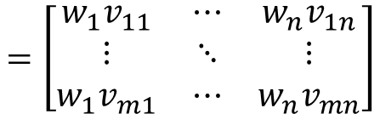

ELECTRE
Step 2: Calculate the weighted normalized decision matrix
This matrix can be calculated by multiplying each column of matrix R with its associated weight w_{j}.
V = RW
$$=\left[\begin{matrix}v_{11} & ⋯ & v_{1n} \\ ⋮ & ⋱ & ⋮ \\ v_{m1} & ⋯ & v_{mn}\end{matrix}\right]$$
$$=\left[\begin{matrix}{w_{1}v}_{11} & ⋯ & w_{n}v_{1n} \\ ⋮ & ⋱ & ⋮ \\ {w_{1}v}_{m1} & ⋯ & {w_{n}v}_{mn}\end{matrix}\right]$$

Slide 18
ELECTRE
Step 2: Calculate the weighted normalized decision matrix
W = (0.2, 0.1, 0.1, 0.1, 0.2, 0.3)
Weights | 0.2 | 0.1 | 0.1 | 0.1 | 0.2 | 0.3
 | Benefit | Benefit | Benefit | Cost | Benefit | Benefit
 | X1 | X2 | X3 | X4 | X5 | X6
Decision Matrix | Maximum Speed (mach) | Ferry Range (NM) | Maximum payload (pounds) | Acquisition Cost ($x10⁶) | Reliability (high-low) | Manueuverability (high-low)
A1 | 0.0934 | 0.0366 | 0.0506 | 0.0507 | 0.0962 | 0.2012
A2 | 0.1168 | 0.0659 | 0.0455 | 0.0599 | 0.0577 | 0.1118
A3 | 0.0841 | 0.0488 | 0.0531 | 0.0415 | 0.1347 | 0.1565
A4 | 0.1028 | 0.0439 | 0.0506 | 0.0461 | 0.0962 | 0.1118

Slide 19
ELECTRE
Step 3: Determine the concordance and discordance set
For each pair of alternatives k and l (k, l = 1,2,…,m and k≠l), the set of decision criteria J = {j|j = 1, 2, …, n} is divided into two distinct subsets.
The concordance set C_{kl} of A_{k} and A_{l} is composed of all criteria for which A_{k} is preferred to A_{l}.
C_{kl} ={ j | x_{kj} ≥ x_{lj}}

Slide 20
ELECTRE
Step 3: Determine the concordance and discordance set
The complementary subset called the discordance set, which is
D_{kl} = { j | x_{kj} < x_{lj}} = J - C_{kl}

Slide 21
ELECTRE
Step 3: Determine the concordance and discordance set
Concordance Set where k ≠ l
 | X1 | X2 | X3 | X4 | X5 | X6
C₁₂ | 0 | 0 | 1 | 1 | 1 | 1
C₁₃ | 1 | 0 | 0 | 0 | 0 | 1
C₁₄ | 0 | 0 | 1 | 0 | 1 | 1
C₂₁ | 1 | 1 | 0 | 0 | 0 | 0
C₂₃ | 1 | 1 | 0 | 0 | 0 | 0
C₂₄ | 1 | 1 | 0 | 0 | 0 | 1
C₃₁ | 0 | 1 | 1 | 1 | 1 | 0
C₃₂ | 0 | 0 | 1 | 1 | 1 | 1
C₃₄ | 0 | 1 | 1 | 1 | 1 | 1
C₄₁ | 1 | 1 | 1 | 1 | 1 | 0
C₄₂ | 0 | 0 | 1 | 1 | 1 | 1
C₄₃ | 1 | 0 | 0 | 0 | 0 | 0
Green highlight means it is in the set.

Slide 22
ELECTRE
Step 3: Determine the concordance and discordance set
Discordance Set
 | X1 | X2 | X3 | X4 | X5 | X6
D₁₂ | 1 | 1 | 0 | 0 | 0 | 0
D₁₃ | 0 | 1 | 1 | 1 | 1 | 0
D₁₄ | 1 | 1 | 0 | 1 | 0 | 0
D₂₁ | 0 | 0 | 1 | 1 | 1 | 1
D₂₃ | 0 | 0 | 1 | 1 | 1 | 1
D₂₄ | 0 | 0 | 1 | 1 | 1 | 0
D₃₁ | 1 | 0 | 0 | 0 | 0 | 1
D₃₂ | 1 | 1 | 0 | 0 | 0 | 0
D₃₄ | 1 | 0 | 0 | 0 | 0 | 0
D₄₁ | 0 | 0 | 0 | 0 | 0 | 1
D₄₂ | 1 | 1 | 0 | 0 | 0 | 0
D₄₃ | 0 | 1 | 1 | 1 | 1 | 1
Green highlight means it is in the set.

Slide 23



ELECTRE
Step 4: Calculate the concordance matrix
The relative value of the concordance set is measured by the concordance index
The Concordance index is equal to the sum of the weights associated with those criteria in the set
The concordance index is c_{kl} between A_{k} and A_{l} is
For the normalized weight set
$$c_{kl}=\sum_{j∈C_{kl}}{w_{j}}$$
$${}/{\sum_{j=1}^{n}{w_{j}}}$$
$$c_{kl}=\sum_{j∈C_{kl}}{w_{j}}$$

Slide 24
ELECTRE
Step 4: Calculate the concordance matrix
The concordance index reflects the relative importance of A_{k} with respect to A_{l}
0 <= c_{kl} <=1
The higher value of c_{kl} indicates that A_{k} is preferred to A_{l}
The resulting concordance matrix C of mxm is not symmetric.

Slide 25
ELECTRE
Step 4: Calculate the concordance matrix
Weights | 0.2 | 0.1 | 0.1 | 0.1 | 0.2 | 0.3
 | X1 | X2 | X3 | X4 | X5 | X6 | Concordance Index
C₁₂ | 0 | 0 | 1 | 1 | 1 | 1 | 0.7
C₁₃ | 1 | 0 | 0 | 0 | 0 | 1 | 0.5
C₁₄ | 0 | 0 | 1 | 0 | 1 | 1 | 0.6
C₂₁ | 1 | 1 | 0 | 0 | 0 | 0 | 0.3
C₂₃ | 1 | 1 | 0 | 0 | 0 | 0 | 0.3
C₂₄ | 1 | 1 | 0 | 0 | 0 | 1 | 0.6
C₃₁ | 0 | 1 | 1 | 1 | 1 | 0 | 0.5
C₃₂ | 0 | 0 | 1 | 1 | 1 | 1 | 0.7
C₃₄ | 0 | 1 | 1 | 1 | 1 | 1 | 0.8
C₄₁ | 1 | 1 | 1 | 1 | 1 | 0 | 0.7
C₄₂ | 0 | 0 | 1 | 1 | 1 | 1 | 0.7
C₄₃ | 1 | 0 | 0 | 0 | 0 | 0 | 0.2

Slide 26
ELECTRE
Step 4: Calculate the concordance matrix
Concordance Matrix (mxm)
--- | 0.7 | 0.5 | 0.6
0.3 | --- | 0.3 | 0.6
0.5 | 0.7 | --- | 0.8
0.7 | 0.7 | 0.2 | ---

Slide 27
ELECTRE
Step 5: Calculate the discordance matrix
The concordance index reflects the relative dominance of a certain alternative over a competing alternative on the basis of the relative weight attached to the successive decision criteria.
So far, no attention has been paid to the degree to which the evaluations of a certain A_{k} are worse than the evaluations of competing A_{l}

Slide 28
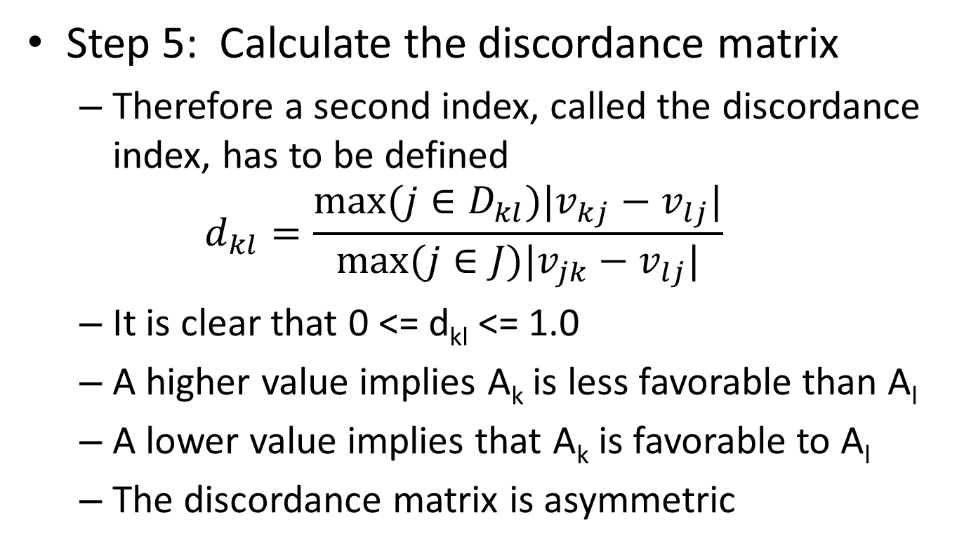
ELECTRE
Step 5: Calculate the discordance matrix
Therefore a second index, called the discordance index, has to be defined
$$d_{kl}=\frac{max⁡(j∈D_{kl})|v_{kj}−v_{lj}|}{max⁡(j∈J)|v_{jk}−v_{lj}|}$$
It is clear that 0 <= d_{kl} <= 1.0
A higher value implies A_{k} is less favorable than A_{l}
A lower value implies that A_{k} is favorable to A_{l}
The discordance matrix is asymmetric

Slide 29
ELECTRE
Step 5: Calculate the discordance matrix
The information in the concordance matrix differs significantly from that contain in the discordance matrix making C and D complementary
Differences among weights are represented by means of the concordance matrix
Differences among attribute values are represented by means of the discordance matrix

Slide 30
ELECTRE
Step 5: Calculate the discordance matrix
 | X1 | X2 | X3 | X4 | X5 | X6 | Max d_{ij} | Max dJ | Discordance Index
D₁₂ | 0.0234 | 0.0293 | 0.0051 | 0.0092 | 0.0385 | 0.0894 | 0.0293 | 0.0894 | 0.3275
D₁₃ | 0.0093 | 0.0122 | 0.0025 | 0.0092 | 0.0385 | 0.0447 | 0.0385 | 0.0447 | 0.8607
D₁₄ | 0.0093 | 0.0073 | 0.0000 | 0.0046 | 0.0000 | 0.0894 | 0.0093 | 0.0894 | 0.1045
D₂₁ | 0.0234 | 0.0293 | 0.0051 | 0.0092 | 0.0385 | 0.0894 | 0.0894 | 0.0894 | 1.0000
D₂₃ | 0.0327 | 0.0171 | 0.0076 | 0.0184 | 0.0770 | 0.0447 | 0.0770 | 0.0770 | 1.0000
D₂₄ | 0.0140 | 0.0220 | 0.0051 | 0.0138 | 0.0385 | 0.0000 | 0.0385 | 0.0385 | 1.0000
D₃₁ | 0.0093 | 0.0122 | 0.0025 | 0.0092 | 0.0385 | 0.0447 | 0.0447 | 0.0447 | 1.0000
D₃₂ | 0.0327 | 0.0171 | 0.0076 | 0.0184 | 0.0770 | 0.0447 | 0.0327 | 0.0770 | 0.4248
D₃₄ | 0.0187 | 0.0049 | 0.0025 | 0.0046 | 0.0385 | 0.0447 | 0.0187 | 0.0447 | 0.4178
D₄₁ | 0.0093 | 0.0073 | 0.0000 | 0.0046 | 0.0000 | 0.0894 | 0.0894 | 0.0894 | 1.0000
D₄₂ | 0.0140 | 0.0220 | 0.0051 | 0.0138 | 0.0385 | 0.0000 | 0.0220 | 0.0385 | 0.5708
D₄₃ | 0.0187 | 0.0049 | 0.0025 | 0.0046 | 0.0385 | 0.0447 | 0.0447 | 0.0447 | 1.0000

Slide 31
ELECTRE
Step 5: Calculate the discordance matrix
Discordance Matrix (mxm)
--- | 0.3275 | 0.8607 | 0.1045
1 | --- | 1 | 1
1 | 0.4248 | --- | 0.4178
1 | 0.5708 | 1 | ---

Slide 32
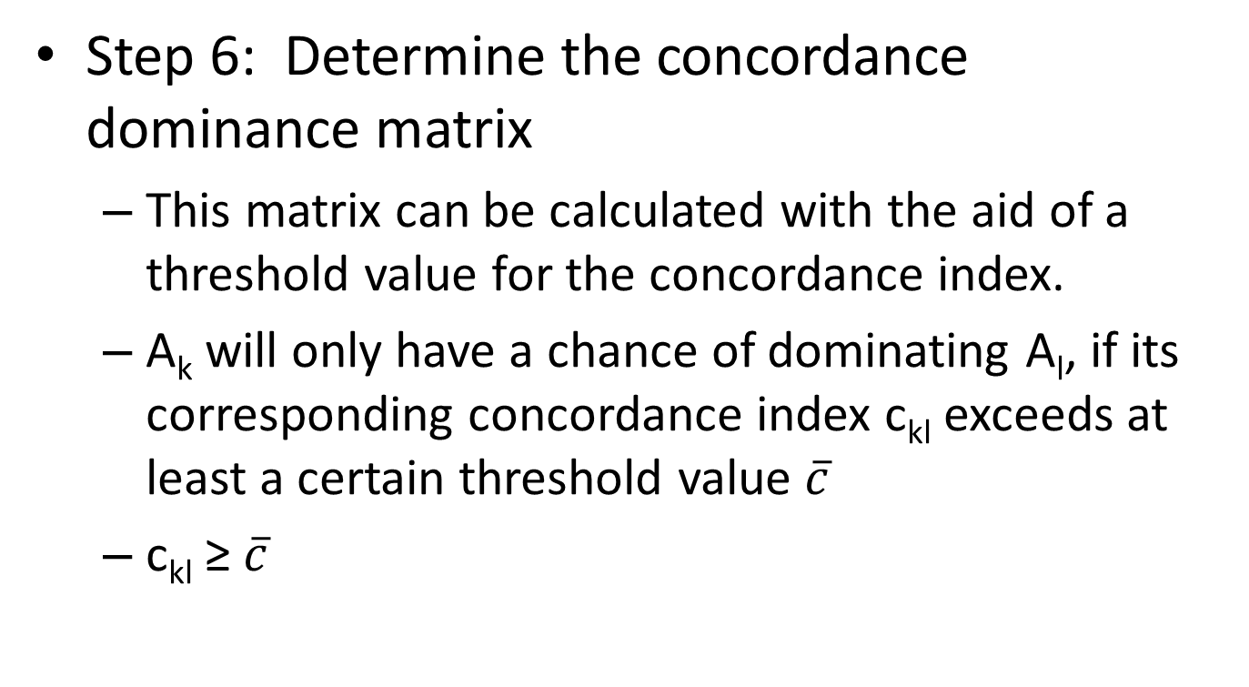
ELECTRE
Step 6: Determine the concordance dominance matrix
This matrix can be calculated with the aid of a threshold value for the concordance index.
A_{k} will only have a chance of dominating A_{l}, if its corresponding concordance index c_{kl} exceeds at least a certain threshold value $\overline{c}$
c_{kl} ≥ $\overline{c}$

Slide 33
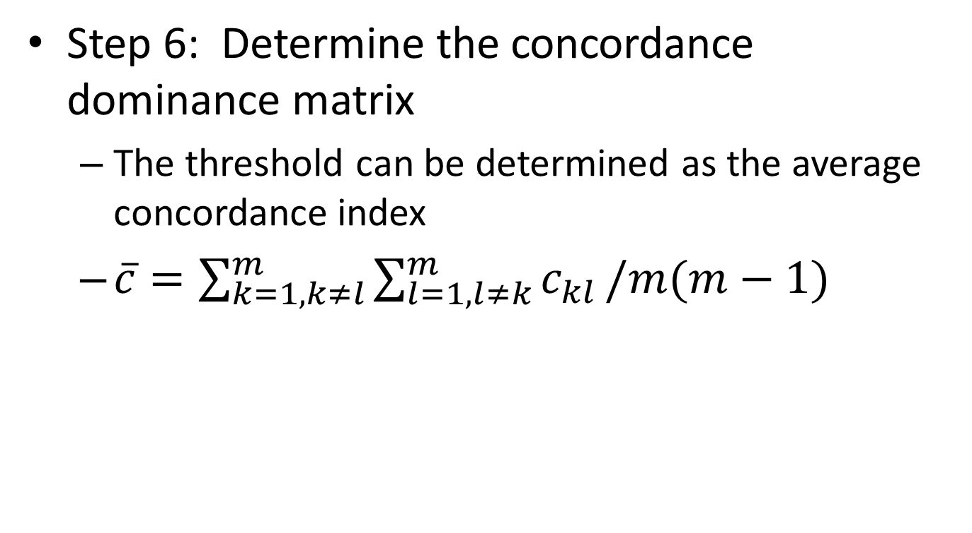
ELECTRE
Step 6: Determine the concordance dominance matrix
The threshold can be determined as the average concordance index
$\overline{c}=\sum_{k=1,k≠l}^{m}{\sum_{l=1, l≠k}^{m}{c_{kl}}}/m(m−1)$

Slide 34
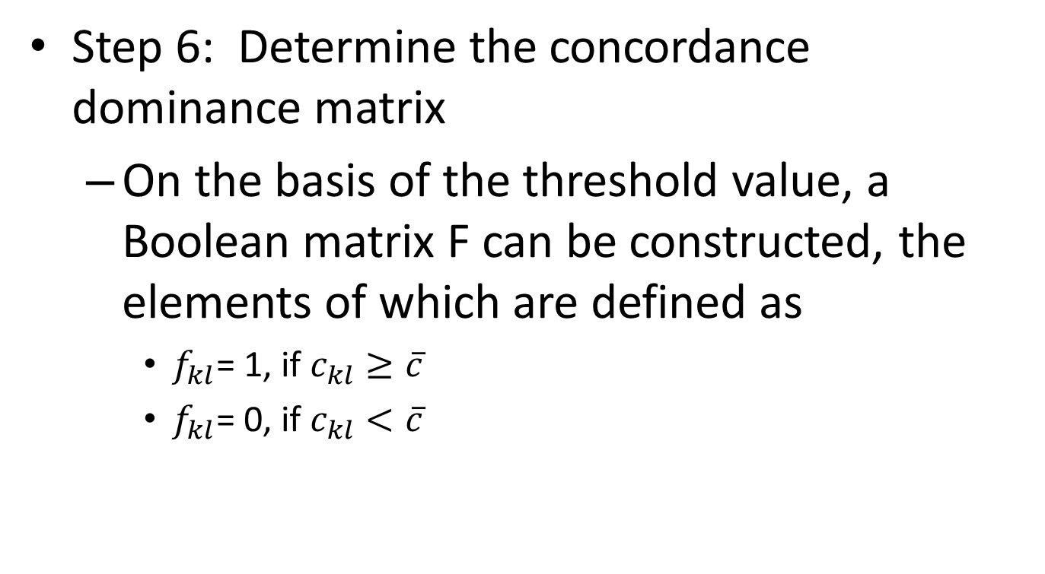
ELECTRE
Step 6: Determine the concordance dominance matrix
On the basis of the threshold value, a Boolean matrix F can be constructed, the elements of which are defined as
$f_{kl}$= 1, if $c_{kl}≥\overline{c}$
$f_{kl}$= 0, if $c_{kl}<\overline{c}$

Slide 35
ELECTRE
Step 6: Determine the concordance dominance matrix
Threshold Value = 0.55
Concordance Dominance Matrix
--- | 1 | 0 | 1
0 | --- | 0 | 1
0 | 1 | --- | 1
1 | 1 | 0 | ---

Slide 36
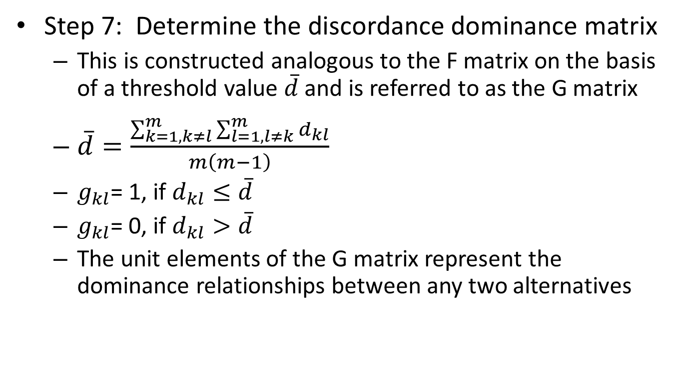
ELECTRE
Step 7: Determine the discordance dominance matrix
This is constructed analogous to the F matrix on the basis of a threshold value $\overline{d}$ and is referred to as the G matrix
$\overline{d}=\frac{\sum_{k=1,k≠l}^{m}{\sum_{l=1, l≠k}^{m}{d_{kl}}}}{m\left(m−1\right)}$
$g_{kl}$= 1, if $d_{kl}≤\overline{d}$
$g_{kl}$= 0, if $d_{kl}>\overline{d}$
The unit elements of the G matrix represent the dominance relationships between any two alternatives

Slide 37
ELECTRE
Step 7: Determine the discordance dominance matrix
Threshold value = 0.7257
Discordance dominance matrix
--- | 1 | 0 | 1
0 | --- | 0 | 0
0 | 1 | --- | 1
0 | 1 | 0 | ---

Slide 38
ELECTRE
Step 8: Determine the aggregate dominance matrix
The next step is to calculate the intersection of the concordance dominance matrix F and discordance dominance matrix G.
The resulting matrix, called the aggregate dominance matrix E, is defined by means of its elements e_{kl}
e_{kl} = f_{kl} ● g_{kl}

Slide 39
ELECTRE
Step 8: Determine the aggregate dominance matrix
Aggregate dominance matrix
--- | 1 | 0 | 1
0 | --- | 0 | 0
0 | 1 | --- | 1
0 | 1 | 0 | ---

Slide 40
ELECTRE
Step 9: Eliminate the less favorable alternatives
The aggregate dominance matrix E gives the partial-preference ordering of the alternatives.
If e_{kl} = 1, then A_{k} is preferred to A_{l} for both the concordance and discordance criteria
A_{k} still has the chance of being dominated by the other alternatives

Slide 41
ELECTRE
Step 9: Eliminate the less favorable alternatives
The condition that A_{k} is not dominated by ELECTRE procedure is,
e_{kl} = 1 for at least one l, l = 1,2,…, m, k≠l
e_{ik} = 0 for all I, I = 1,2, …, m, i≠k, i≠l

Slide 42
ELECTRE
Step 9: Eliminate the less favorable alternatives
This condition appears difficult to apply, but the dominated alternatives can easily be identified in the E matrix
If any column of the E matrix has at least one element of 1, then this column is ‘ELECTREcally’ dominated by the corresponding rows(s).
Hence, we simply eliminate any column(s) which have an element of 1.

Slide 43
ELECTRE
Step 9: Eliminate the less favorable alternatives
--- | 1 | 0 | 1
0 | --- | 0 | 0
0 | 1 | --- | 1
0 | 1 | 0 | ---
Eliminate Columns that have a ‘1’

Slide 44
ELECTRE
Step 9: Eliminate the less favorable alternatives
The E matrix renders the following over-ranking relationships
A₁ → A₂
A₁ → A₄
A₃ → A₂
A₃ → A₄
A₄ → A₂
A₂ and A₄ are dominated by A₁and A₃
We cannot tell the preference relation between A₁and A₃
A₂ and A₄ can be eliminated by the ELECTRE method

Slide 45
ELECTRE
Step 9: Eliminate the less favorable alternatives
Graph of preferences
A₁
A₂
A₃
A₄

Slide 46
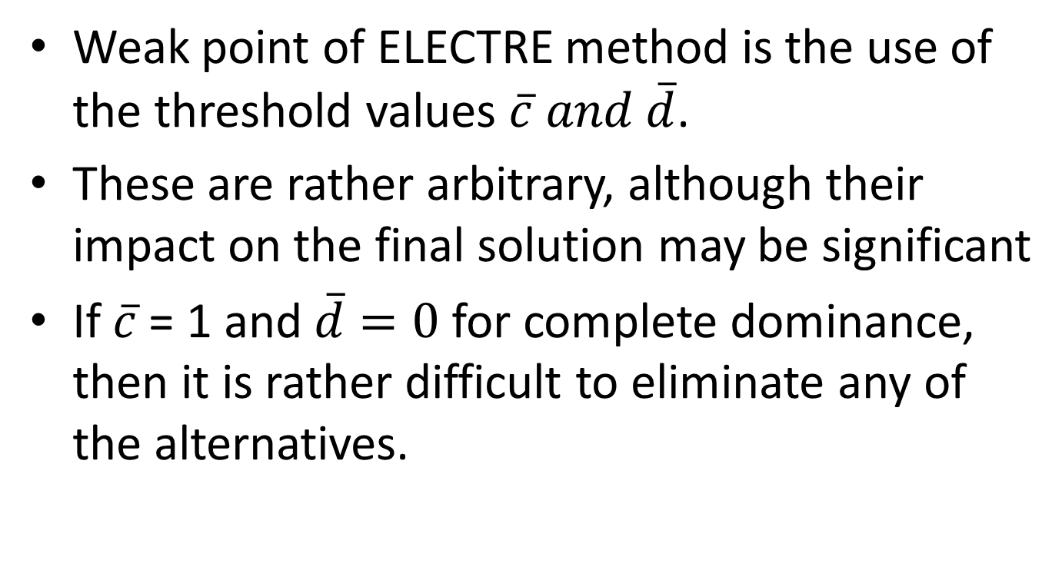
ELECTRE
Weak point of ELECTRE method is the use of the threshold values $\overline{c} and \overline{d}$.
These are rather arbitrary, although their impact on the final solution may be significant
If $\overline{c}$= 1 and $\overline{d}=0$ for complete dominance, then it is rather difficult to eliminate any of the alternatives.

Slide 47
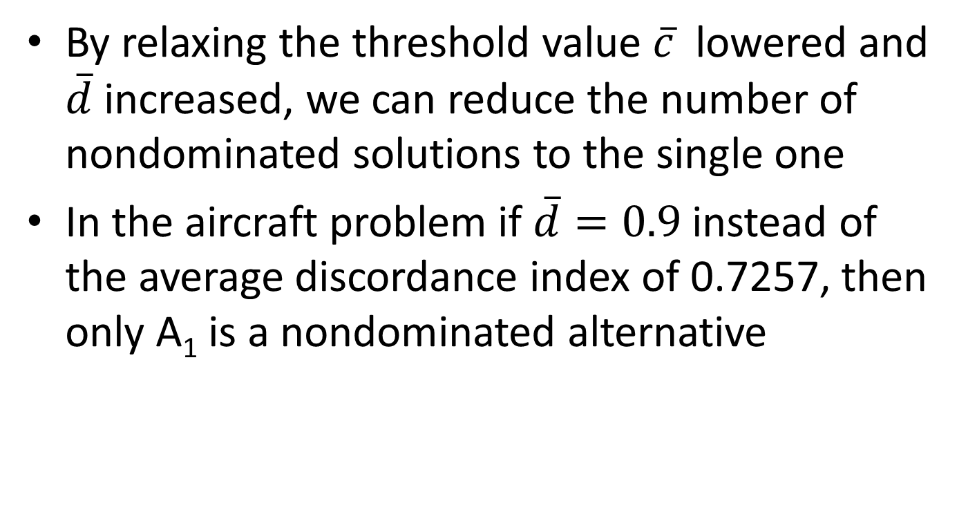
ELECTRE
By relaxing the threshold value $\overline{c}$ lowered and $\overline{d}$ increased, we can reduce the number of nondominated solutions to the single one
In the aircraft problem if $\overline{d}=0.9$ instead of the average discordance index of 0.7257, then only A₁ is a nondominated alternative

Slide 48
ELECTRE
Van Delft and Nijkamp introduced the net dominance relationships for the complementary analysis of the ELECTRE method
The defined a net concordance dominance value which measured the degree to which the total dominance of the A_{k} exceeds the degree to which all competing alternative dominate A_{k}

Slide 49
Complementary ELECTRE
The net concordance of an alternative p (c_{p}):
c_{p} =
The net discordance of an alternative p (d_{p}):
d_{p} =
–
–

Slide 50
Complementary ELECTRE
A_{k} has a higher chance of being accepted with the higher c_{k} and lower d_{k}.
Final selection should satisfy the condition that its net concordance dominance value should be at a maximum and its net discordance dominance at a minimum.

Slide 51
Complementary ELECTRE
The procedure is to rank the alternatives according to their net concordance and discordance dominance values
The alternatives that scores on the average as the highest one can be selected as the final solution.

Slide 52
Complementary ELECTRE
For the aircraft problem
Net concordance dominance values are:
c₁ = 0.3, c₂ = -0.9, c₃ = 1.0, c₄ = -0.4
Net discordance dominance values are:
d₁ = -1.7059, d₂ = 1.6762, d₃ = -1.0183, d₄ = 1.048
A₁ and A₃ rank first and second with c_{k} and d_{k} and are acceptable solutions

Slide 53
ELECTRE II
Roy and Bertier introduced some variations at ELECTRE I in 1971 (Vincke, 1992):
1. Building the outranking relation
Two concordance thresholds and a discordance threshold (or a discordance set) are defined
A strong outranking relation (S^{F}) and a weak outranking relation (S^{f}) are built
2. Exploiting the outranking relation
A complete preorder is obtained by calculating the degrees of the graph’s vertices (based on S^{F})
Ties are eliminated on the basis of S^{f}

Slide 54
Outranking Relations
Strong and weak outranking relations:
a_{i} S^{F} a_{j}
a_{i} S^{f} a_{j}
>

Slide 55
ELECTRE METHOD FAMILY
ELECTRE (I) is designed for choice problems
ELECTRE II aims to rank the alternatives
ELECTRE III concerns ranking problems involving quasi and/or pseudo criteria; bases upon a valued outranking relation
ELECTRE IV ranks actions without introducing any weighting of criteria

Slide 56
IMSE 991 Multiple Criteria Decision Making
Lecture 10
ELECTRE

